Slide 1
Approximations and Errors

Slide 2
Approximations and Errors
The major advantage of numerical analysis is that a numerical answer can be obtained even when a problem has no “analytical” solution.
Although the numerical technique yielded close estimates to the exact analytical solutions, there are errors because the numerical methods involve “approximations”.

Slide 3
Computer based solutions
The major steps involved to solve a given problem using a computer are:
Modeling: Setting up a mathematical model, i.e., formulating the problem in mathematical terms, taking into account the type of computer one wants to use.
2. Choosing an appropriate numerical method (algorithm) together with a preliminary error analysis (estimation of error, determination of steps, size etc.)
3. Programming, usually starting with a flowchart showing a block diagram of the procedures to be performed by the computer and then writing, say, a C++ program.
4. Operation or computer execution.
5. Interpretation of results, which may include decisions to rerun if further data are needed.

Slide 4
Accuracy and Precision
Accuracy is related to the closeness to the true value.
Precision is related to the closeness to other estimated values.
Bias refers to systematic deviation of values from the true value.

Slide 5
Significant Figures
Significant figures of a number are those that can be used with confidence.
Rules for identifying sig. figures:
All non-zero digits are considered significant. For example, 91 has two significant digits (9 and 1), while 123.45 has five significant digits (1, 2, 3, 4 and 5).
Zeros appearing anywhere between two non-zero digits are significant. Example: 101.12 has five significant digits.
Leading zeros are not significant. For example, 0.00052 has two significant digits
Trailing zeros are generally considered as significant. For example, 12.2300 has six significant digits.

Slide 6
Significant Figures
Scientific Notation
If it is not clear how many, if any, of zeros are significant. This problem can be solved by using the scientific notation
0.0013 = 1.3*10⁻³ 0.00130 = 1.30*10⁻³
2 sig. figures 3 sig. figures
If a number is expressed as 2.55 *10⁴, (3 s.f), then we are only confident about the first three digits. The exact number may be 25500, 25513, 25522.6 , .. etc. So we are not sure about the last two digits nor the fractional part- If any.
However, if it is expressed as 2.550 * 10⁴, (4 s.f), then we are confident about the first four digits but uncertain about the last one and the fractional part – if any.

Slide 7
Why measure errors?
To determine the accuracy of numerical results.
To develop stopping criteria for iterative algorithms.

Slide 8
Error Definition
Numerical errors arise from the use of approximations
Error
Inherent
Truncation
Round-off
1. Inherent errors or experimental errors arise due to the assumptions made in the
mathematical modeling of problem. It can also arise when the data is obtained from
certain physical measurements of the parameters of the problem. i.e., errors arising
from measurements.
2. Truncation errors are those errors corresponding to the fact that a finite (or infinite)
sequence of computational steps necessary to produce an exact result is “truncated”
prematurely after a certain number of steps.
3. Round of errors are errors arising from the process of rounding off during
computation. These are also called chopping, i.e. discarding all decimals from some
decimals on.

Slide 9
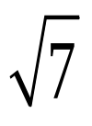
Round-off Errors
Numbers such as π, e, or cannot be expressed by a fixed number of significant figures.
Computers use a base-2 representation, they cannot precisely represent certain exact base-10 numbers
Fractional quantities are typically represented in computer using “floating point” form, e.g.,
Example:
π = 3.14159265358 to be stored carrying 7 significant digits.
π = 3.141592 chopping
π = 3.141593 rounding

Slide 10
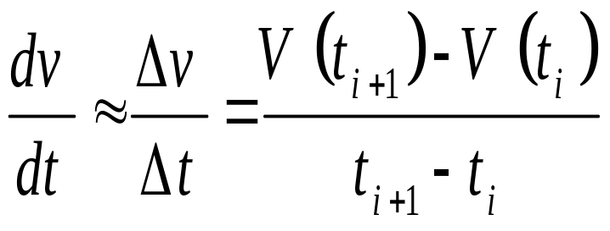
Truncation Errors
Truncation errors are those that result using approximation in place of an exact mathematical procedure.

Slide 11

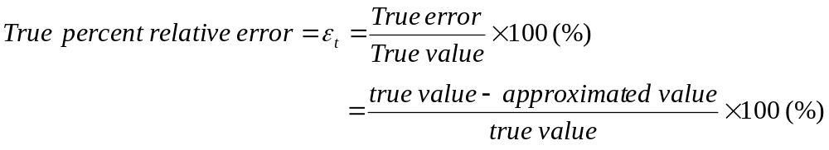
True Error
True error (E_{t}) Defined as the difference between the true value in a calculation and the approximate value found using a numerical method etc.
True error (E_{t}) or Exact value of error
= true value – approximated value
True percent relative error ( ) is defined as the ratio between the true error, and the true value.

Slide 12
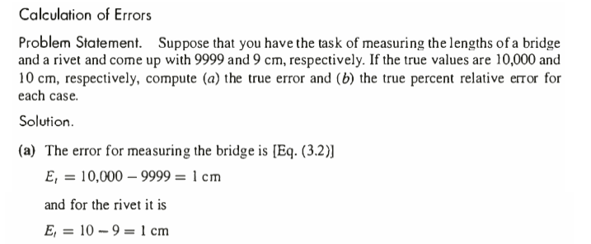
Example 3.1

Slide 13
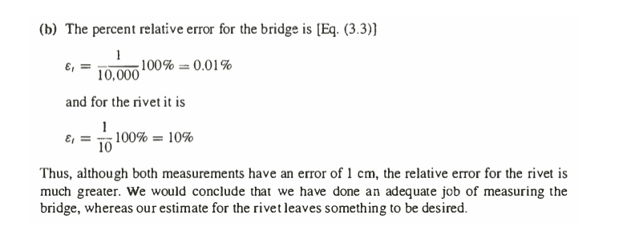
Example 3.1

Slide 14
Approximate Error
The true error is known only when we deal with functions that can be solved analytically.
In many applications, a prior true value is rarely available.
For this situation, an alternative is to calculate an approximation of the error using the best available estimate of the true value as:
Approximate error is defined as the difference between the present approximation and the previous approximation.
Approximate Error (E_{a}) = Present Approximation – Previous Approximation and Relative Approximate Error

Slide 15
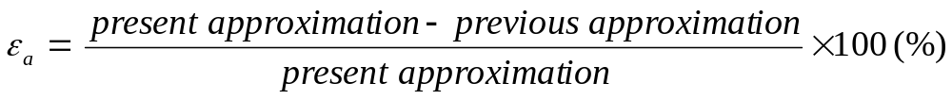


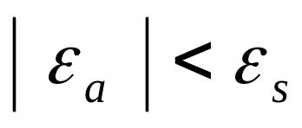
Approximate Error
In many numerical methods a present approximation is calculated using previous approximation:
Note:
- The sign of or may be positive or negative
- We interested in whether the absolute value is lower than a prespecified tolerance (ε_{s}), not to the sign of error. Thus, the computation is repeated until (stopping criteria):

Slide 16
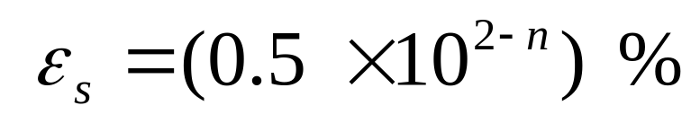
Prespecified Error
We can relate (ε_{s}) to the number of significant figures in the approximation,
So, we can assure that the result is correct to at least n significant figures if the following criteria is met:

Slide 17
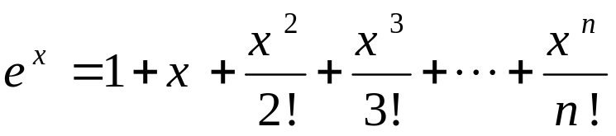
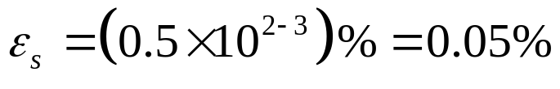
Example
The exponential function can be computed using Maclaurin series as follows:
Estimate e^{0.5} using series, add terms until the absolute value of approximate error ε_{a} fall below a pre-specified error ε_{s} conforming with three significant figures.
  {The exact value of e^{0.5}=1.648721…}
Solution

Slide 18

Using one term:
Using two terms:
Using three terms:
Terms | Results | ε_{t}% | ε_{a}%
1 | 1.0 | 39.3 | ---
2 | 1.5 | 9.02 | 33.3
3 | 1.625 | 1.44 | 7.69
4 | 1.645833333 | 0.175 | 1.27
5 | 1.648437500 | 0.0172 | 0.158
6 | 1.648697917 | 0.00142 | 0.0158

